Slide 1

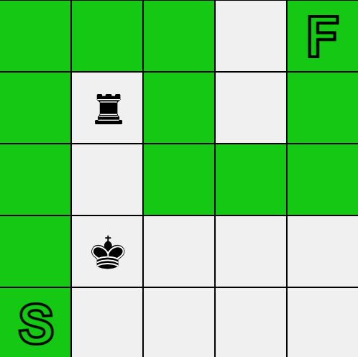
Chess Snake IART Project
Carlos Gomes – up201906622
Domingos Santos – up201906680
Filipe Pinto – up201907747

Slide 2
Specifications
The main goal for this project is to, based on Artificial Inteligence skills and search algorithms, implement a version of the puzzle “Chess Snake”;
The main goal of the puzzle is to connect the bottom left tile of the board with the top right tile, by creating a path according to some rules;
The rules are:
- No loops are allowed;
- Each chess piece attacks an equal number of squares of the choose path;
- Pieces may not be crossed by the path;
- The snake cannot touch itself.

Slide 3
Search Problem Formulation
State Representation: The board is represented by a matrix (list of lists), start and end tile are represented by the char ‘s’ and ‘f’, respectively, each chess piece is also represented by a char (king – k, queen – q, bishop – b, knigth – n, rook –r and pawn - p) the path tiles are represented with a 1 and the empty tiles with a 0. Each chess piece has its own type and position as well as a counter that counts each time it attacks the snake, a list containing all the positions where it can attack. Every tile has a position (x, y) to store the corresponding index of the matrix and theres also a snake object which stores the path selected.
Initial state: The initial state is represented with the given chess tiles defined in the board, the start and finish tiles well-marked, snake path with the initial tile and cost stars at 0 .
Final state: state with a chosen path which may follow the rules defined in the game description. So it will be a matrix similiar with the initial state but, in this case, with the tiles representing the solution path marked with a 1.
Solution Cost – Each move costs 1, so the final cost will be the total length of the snake.
Heuristic – As the main goal of the puzzle is to find a way to connect the 2 edges of the board, an heuristic function can be defined as the remaining Manhattan distance from the current snake block to the finish tile, the largest difference between the chess piece with most attacks and the one with least attacks or a combination of both

Slide 4
Search Problem Formulation
Operators | Pre-condition | Effects | Cost
Move up | - The above tile of the last piece of the snake is empty ( no chess piece nor snake piece); - The last tile of the snake is not on the top row. - The 5 adjacent tiles (including diagonal) are not another snake block | The above tile of the last piece of the snake is now part of the path too; Update matrix’s values. (x, y-1) changes to 1. Updates the snake path Cost +=1 Current position is now (x,y-1) | 1
Move Down | - The tile on the bottom of the last piece of the snake is empty (no chess piece nor snake piece); - The last tile of the snake is not on the last row. - The 5 adjacent tiles (including diagonal) are not another snake block | The tile on the bottom of the last piece of the snake is now part of the path too; Update matrix’s values. (x, y+1) changes to 1. Updates the snake path Cost +=1 Current position is now (x,y-1) | 1
Move Left | - The tile on the left of the last piece of the snake is empty ( no chess piece nor snake piece); - The last tile of the snake is not on the first column. - The 5 adjacent tiles (including diagonal) are not another snake block | The tile on the left of the snake is now part of the path too; Update matrix’s values. (x-1, y) changes to 1. Updates the snake path Cost +=1 Current position is now (x,y-1) | 1
Move Right | - The tile on the right of the last piece of the snake is empty ( no chess piece nor snake piece); - The last tile of the snake is not on the last column. - The 5 adjacent tiles (including diagonal) are not another snake block | - The tile on the right of the snake is now part of the path too; - Update matrix’s values. (x+1, y) changes to 1. Updates the snake path Cost +=1 Current position is now (x,y-1) | 1
Operators

Slide 5
Implementation
Prefered Languages: Python.
Data structures: astar (A class used to implement a-star algorithm), board (A class used to implement the game logic and its status), dfs (A class used to implement the dfs algorithm), display (A class used to implement graphic interface using pygame), greedy (A class used to implement Greedy algorithm), menu (A class used to implement the menu in the terminal), pieces (A class used to represent the chess piece), snake (A class used to represent the snake/path) and state (A class used to represent a game state for algorithms).
The initial state is defined by reading the saved text files with board information.
Implemented libraries: numpy, pygame

Slide 6
Approach
The game allows two possible interactions between user and machine. First, we developed a single player mode, where the user can create his own path and then check if it is correct or not based on the game’s rules;
Then, we created an AI mode, that based on chosen level, generates a correct answer, using many algorithms such as:
DFS, Greedy and A-Star (these last 2 featuring 3 distinct heuristics) to calculate the best path from Start Tile to Final Tile. Each one had a different performance that will be analyzed later.
Evaluation Function: The path created from the start until the of end file should respect the rules such as the non existance of collisions between snake blocks, chess pieces may not be crossed by the path ( both evaluated in the course of the search) and each chess piece attacks an equal number of squares of the choose path (calculated when the end tile is reached; if ok returns otherwise continues the search);
Heuristics: For the AI mode, heuristics were important for implementing A-star and Greedy Algorithms and to generate the solution more efficiently:
Heuristic 1: Manhattan Distance;
Heuristic 2: Maximum Chess Piece Attacks Difference ( we want the attacks to be as close as possible )
Heuristic 3: Manhattan Distance + Maximum Chess Piece Attacks Difference
Note: For the A-Star algorithm we used the function f ( f (n) = g(n) + h(n)) where g is the total cost (path distance) and h was the chosen heuristic.

Slide 7
Results
Graphic 1: Time that each algorithm takes to solve the puzzle
Graphic 2: Number of nodes that each algorithm visits to solve the puzzle

Slide 8
Statistics – Algorithm analysis
Analysing the results obtained for each algorithm, we observe that:
DFS has, on average, the biggest number of expanded nodes, which results on more memory used;
Greedy is the fastest in execution time and has the lowest number of expanded nodes;
A-star is the most incosistent algorithm in terms of execution time, although for expanded nodes is the DFS algorithm;
One condition that could affect the results are the order of nodes are expanded. We used a simple list with all 4 possible moves (Up, Down, Left, Right) and the order that each move is used may allow different execution times with some puzzles being faster and others slower.

Slide 9
Statistics – Heuristic analysis
Analysing the results obtained for each heuristic, we observe that :
Heuristic 2 is the fastest in terms of execution time and memory usage with Greedy algorithm. With A*, heuristic 1 is the fastest;
In general heuristic 3 is the most consistent, in all algorithms;
A simple explanation for the heuristic results, might be the fact that the cost (path distance) is no directly associated with the solution, because a good solution is a solution that guarantees that each chess piece attacks an equal number of snake blocks and not the shortest one.

Slide 10
Conclusion
During the elaboration of this project, we were able to study and verify the effectiveness of the implemented algorithms.
Considering that this Project mixes interactive and displayable content using pygame and artificial intelligence algorithms makes it more engaging.
The most challenging part of this project was to implement the rules of the game due to multiple verifications needed to be done, for example making a simple move. So, for us the game implementation was a little bit more difficult than the algorithms itself.
In addiction, this Project helped us getting to know more about the content studied in theoretical and practical classes since we had to investigate ways of sorting out some problems related to rules and algorithm implementations.
To sum up, above the complexity of this game and the problems we faced, we consider that the assignment was successfully completed and that all goals were fulfilled.

Slide 11
References
https://erich-friedman.github.io/puzzle/snake/
https://moodle.up.pt/ (course files)
https://pedros.works/chess-snake
Python 3 Documentation;

